Slide 1
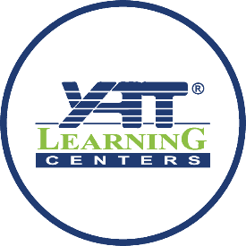

PROJECT NAME : Smart cities INITIATIVE Name : Pioneers of digital Egypt initiative team name : the ink slingers MEMBERS : Zahra Omar Noha Saber Rahma Hamada Aya Karam Reem Abdelhakem instractor : eng Mohamed kamar data : 12 abril 2025

Slide 2





Programs

Slide 3
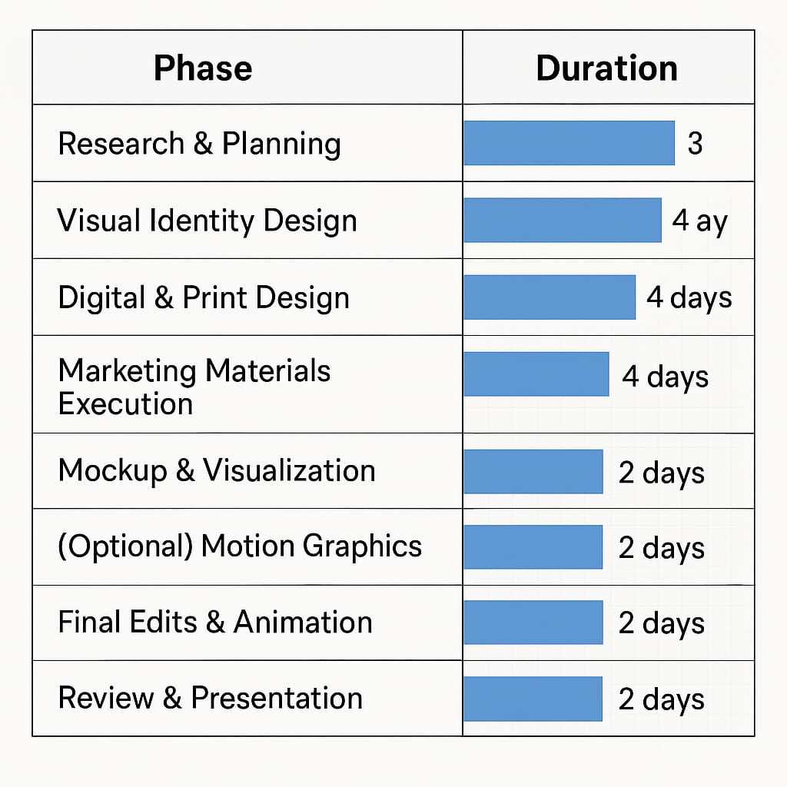
Project timeline

Slide 4
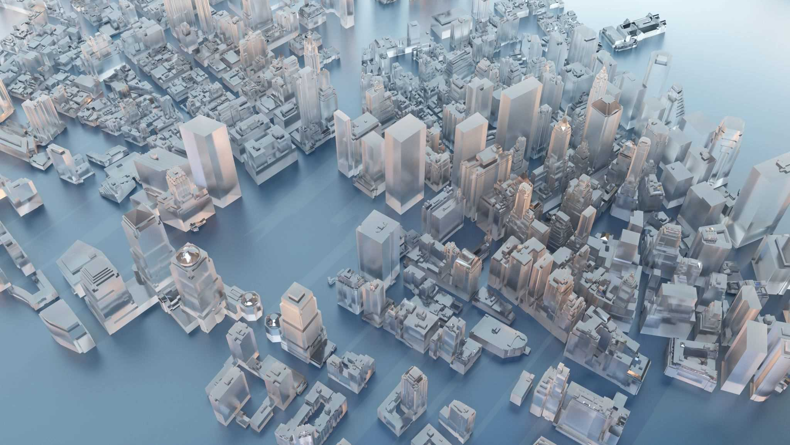
what are smart cities? Smart cities are urban areas that rely on technology and data to enhance quality of life, increase efficiency, and provide innovative solutions to everyday challenges. This project aims to visually represent the concept of smart cities through awareness-oriented designs that highlight the key elements of a smart city in a modern and engaging style.

Slide 5
Project Objectives
Simplifying the concept of smart cities through visual design.
01
Creating awareness-focused designs targeted at young audiences.
02
Using modern design techniques such as flat design and infographics.
03
Utilizing visual elements to communicate the idea clearly and without complexity.
04

Slide 6
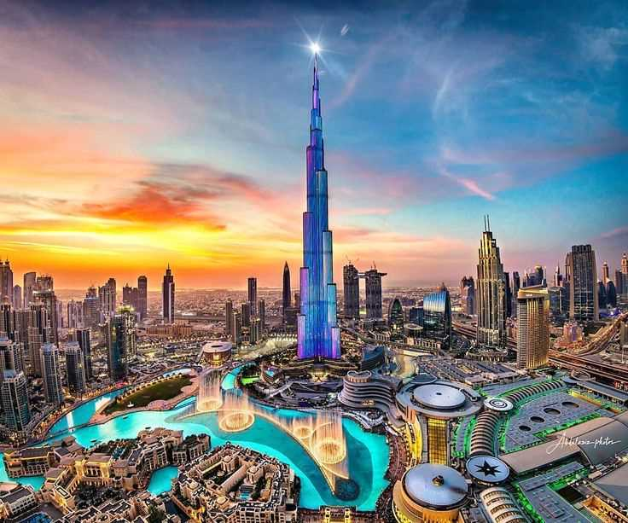
Research & Inspiration
In our design, we relied on research into the key features of smart cities, such as:
Smart transportation systems
Clean energy
Intelligent buildings
Digital services

Slide 7
Design Concept
we chose a design style that focuses on clarity and modernity, using colors associated with technology such as blue, gray, and green. The design represents a fully integrated smart city, delivering the concept smoothly through elements such as:
Icons representing WiFi,Electric cars and solar energy
Simple maps
Clean and clear lines

Slide 8
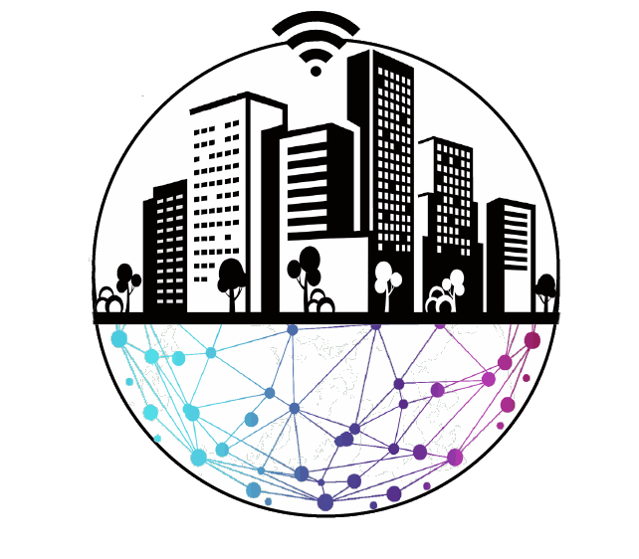
LOGO
This logo represents a vision of an integrated city built on smart connectivity between people, the environment, and technology.
The circular shape symbolizes that technology has become an essential part of urban infrastructure.
Gradient colors were used to highlight the diversity and integration of smart services.

Slide 9
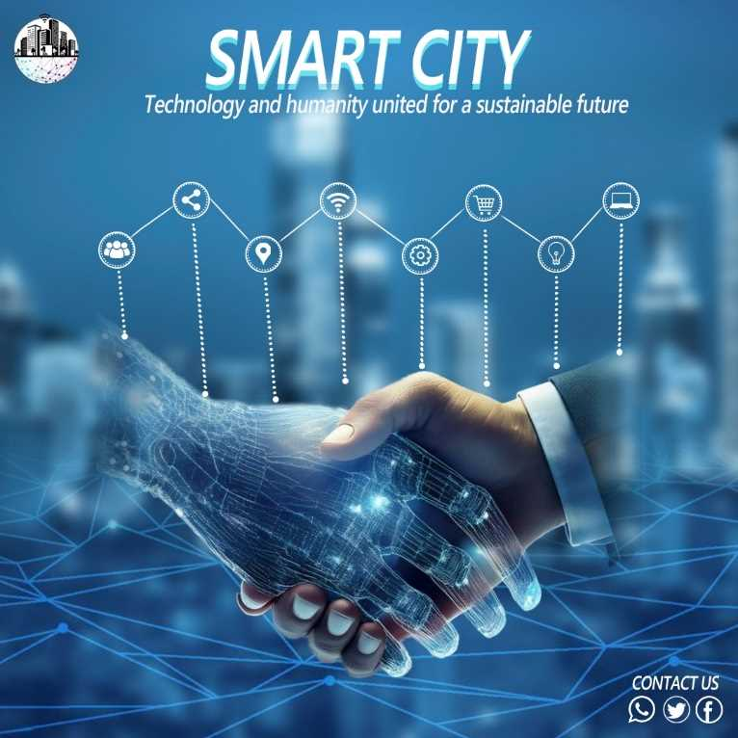
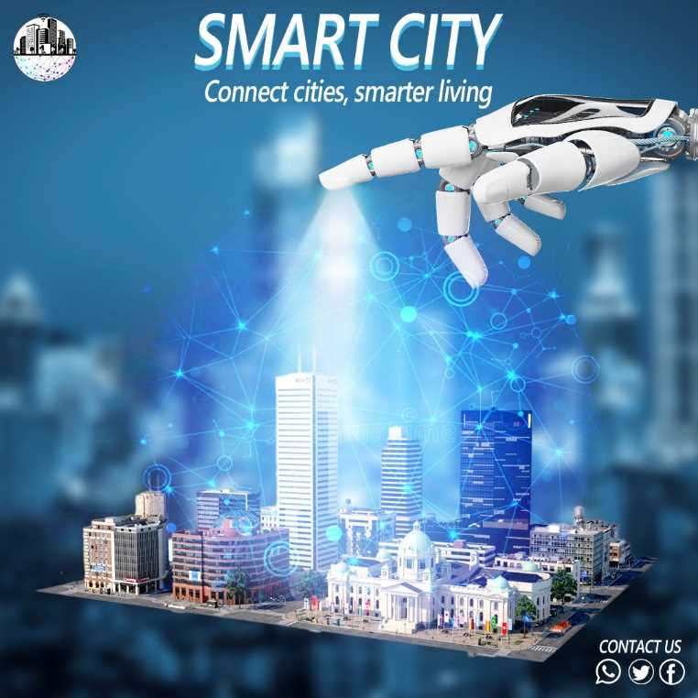
Visual Showcase
The first design conveys the impression of an advanced city that relies on technology and connectivity to improve the lives of its residents.
The second design depicts a handshake between a human hand and a digital or technological hand, with various technology icons above. It reflects the idea of integrating technology and humanity for a sustainable future, as stated in the accompanying text "Technology and humanity united for a sustainable future".

Slide 10
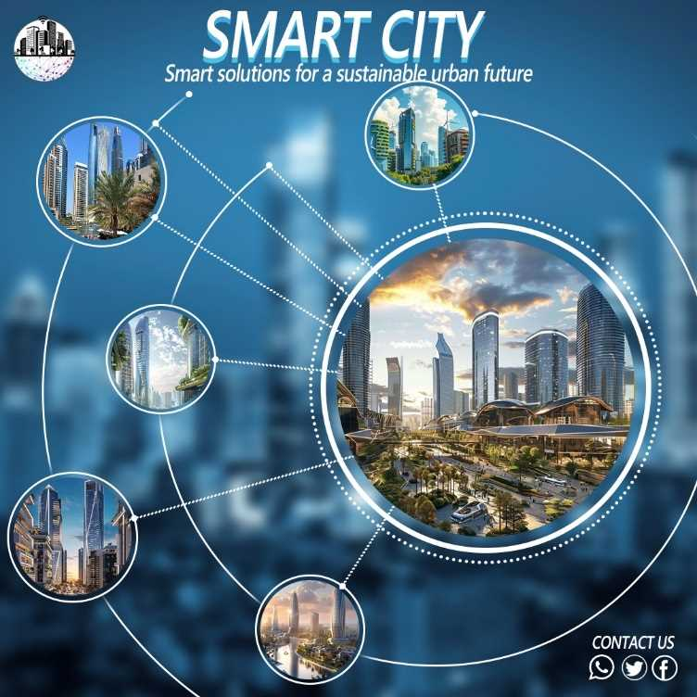
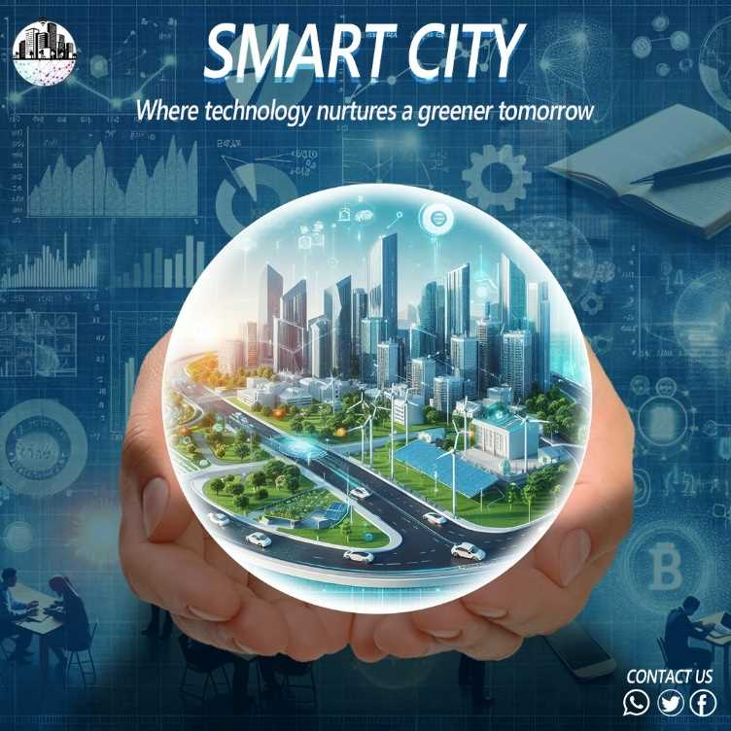
Visual Showcase
First Design :This image presents a futuristic vision of a smart city where technology is integrated with environmental sustainability. The design shows a city inside a transparent sphere held by hands, symbolizing protection and development of smart communities through innovation and green technologies.
Second Design :This image focuses on the concept of a smart city by showcasing multiple snapshots of an advanced, connected urban environment. It illustrates sustainable and innovative solutions based on smart infrastructure and modern urban planning.

Slide 11
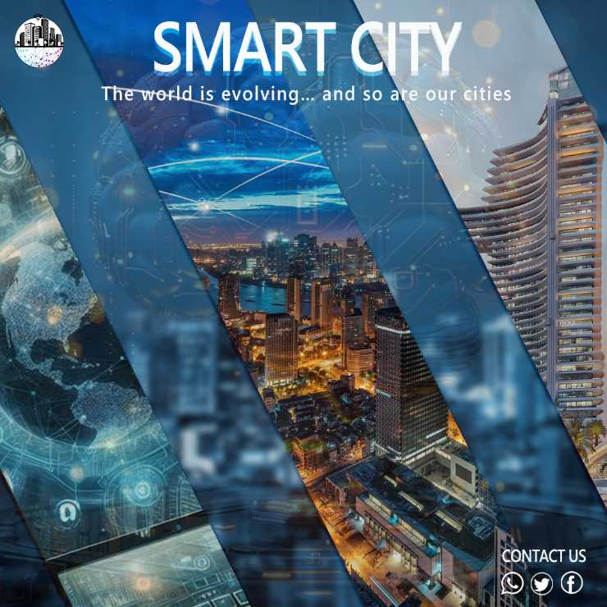
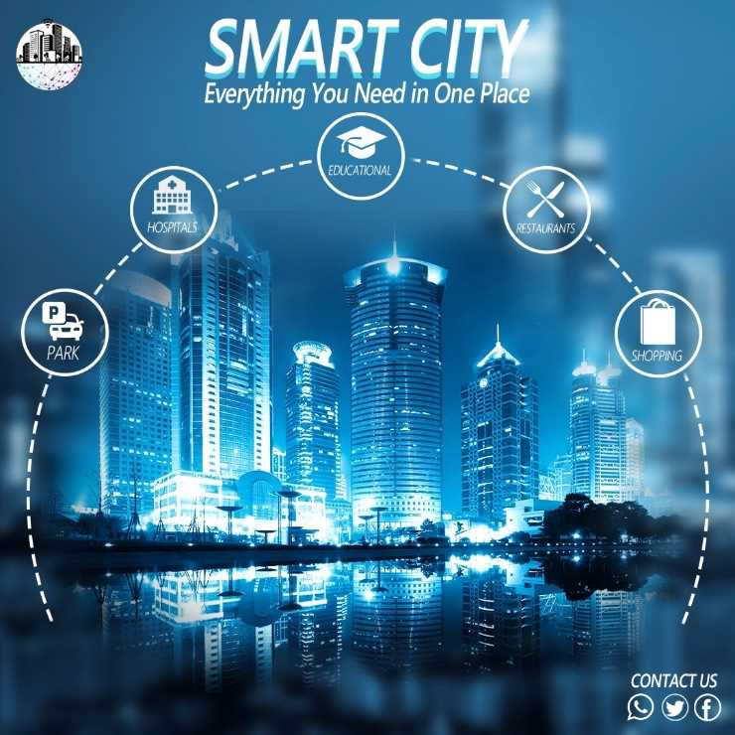
Visual Showcase
The first design, Smart cities grow with technology to build modern, connected environments.
Point: Combines tech with infrastructure to enhance daily life
The second design Integrated Smart City: Everything you need in one place.
Convenience & Ease: Easy access to essential services (health, education, shopping, leisure).Modern Living: Design focused on quality of life and ease of living.

Slide 12
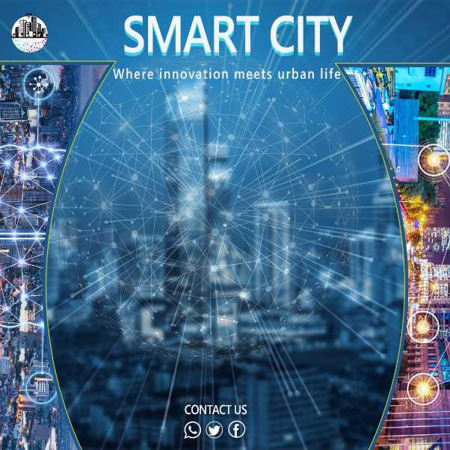
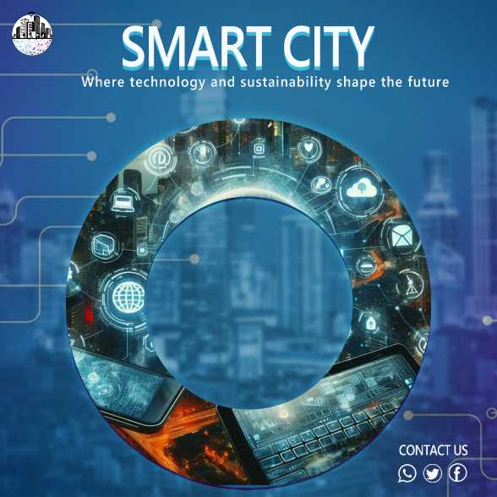
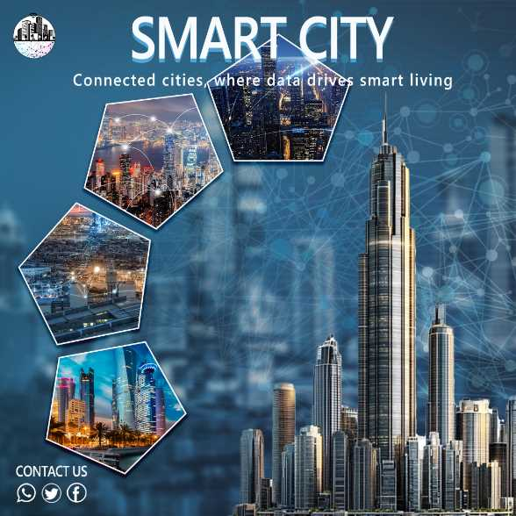
Visual Showcase
Connected cities, where data drives smart living"🔹 Smart cities use data and technology to connect systems like transport, energy, and security, making life easier and more efficient.
Where technology and sustainability shape the future"🔹 Smart cities focus on clean, smart solutions to protect the environment and support sustainable urban growth.
Where innovation meets urban life"🔹 Smart cities bring innovation into daily life through AI and smart technologies that help manage traffic, services, and resources better.

Slide 13
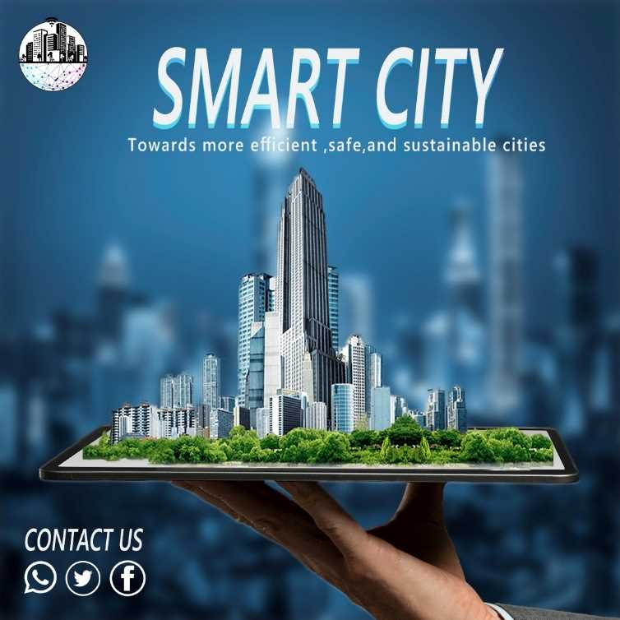
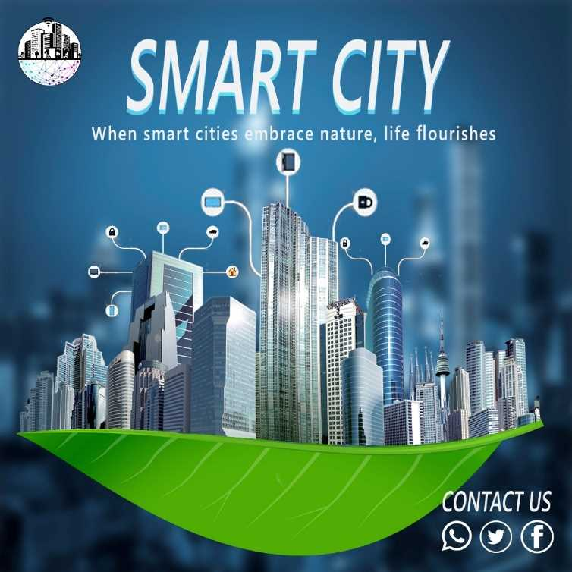
Visual Showcase
The first design emphasizes how digital infrastructure can support the development of safer, more efficient, and sustainable urban spaces — represented by a smart city emerging from a tablet.
The second design focuses on the coexistence of nature and technology, showing a green leaf supporting a digital city — a metaphor for eco-friendly innovation.

Slide 14
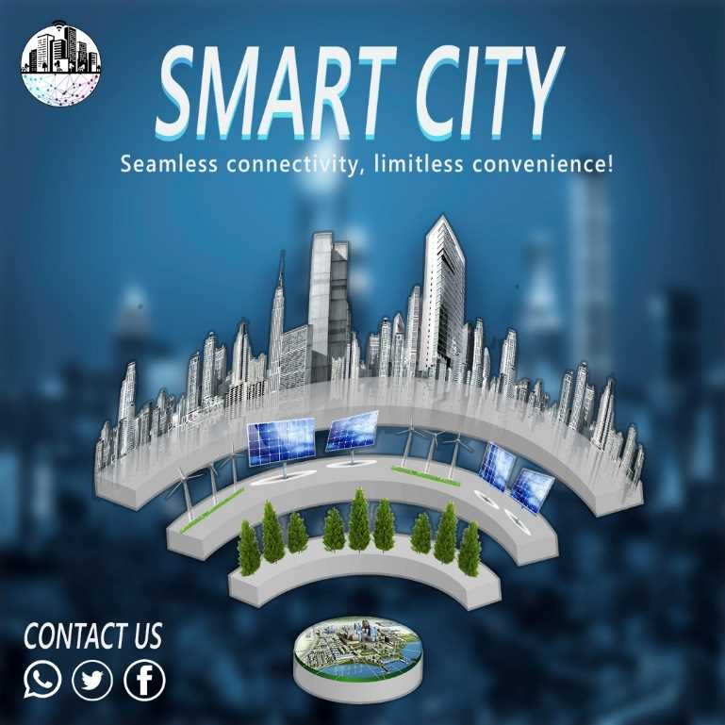
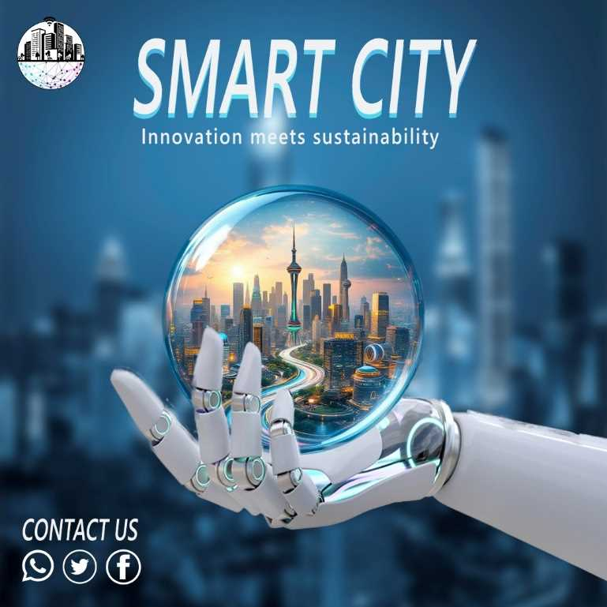
Visual Showcase
The first design shows the integration of smart buildings, solar panels, and modern tech to create a highly connected and efficient city.
Extra Point: The presence of trees and solar panels reflects the blend of environmental sustainability with innovative technology.
The second design highlights how smart cities use advanced technology and AI to create a sustainable future by improving infrastructure and energy efficiency
.Extra Point: The robotic hand symbolizes the role of artificial intelligence and automation in managing modern cities.

Slide 15
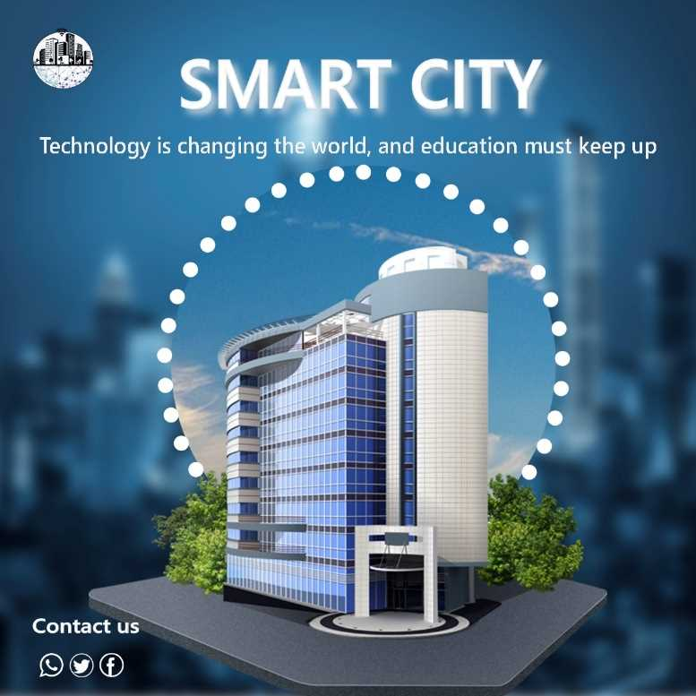
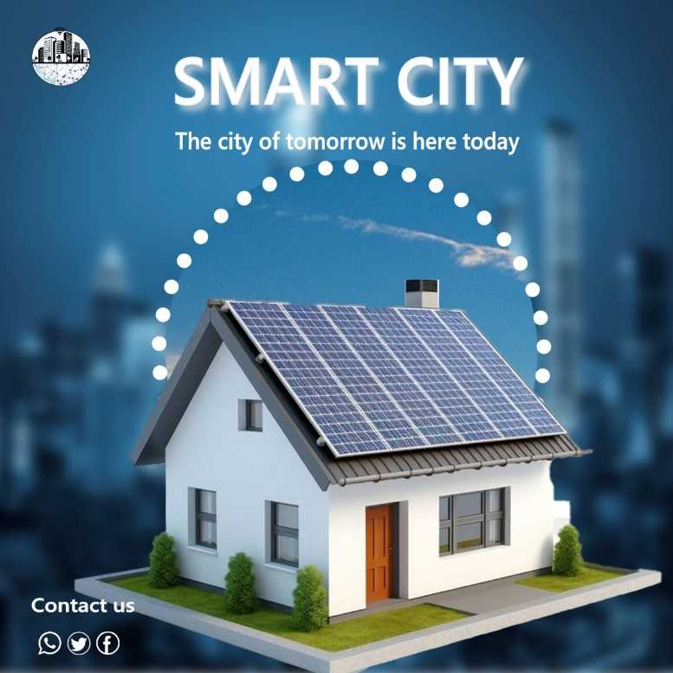
Visual Showcase
The first design Smart Education: A modern educational building keeping pace with technological advancements in smart cities.
Technology in Education: Integrating technology into the learning environment to enhance learning and innovation.
The second design Sustainable Smart City: A model of a solar-powered home in the city of tomorrow.
Clean Energy: Utilizing solar panels for clean and renewable electricity generation.
Environmental Sustainability: Focus on eco-friendly solutions and reducing reliance on traditional energy sources.

Slide 16
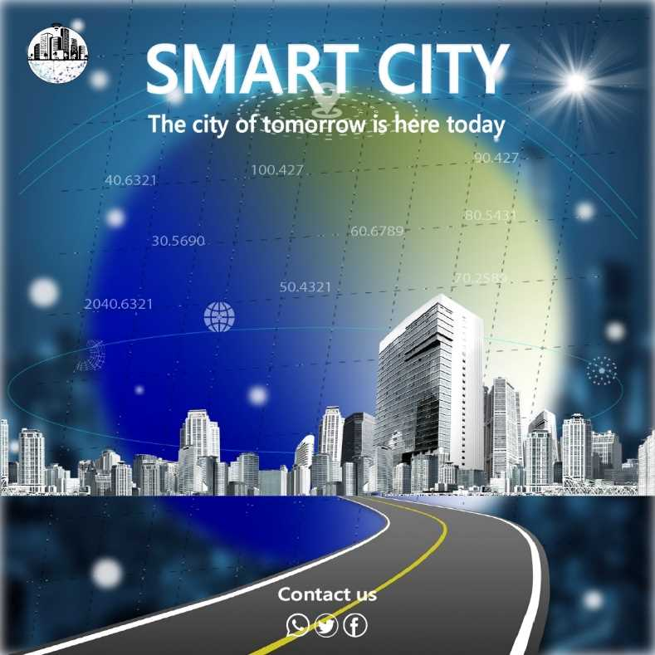
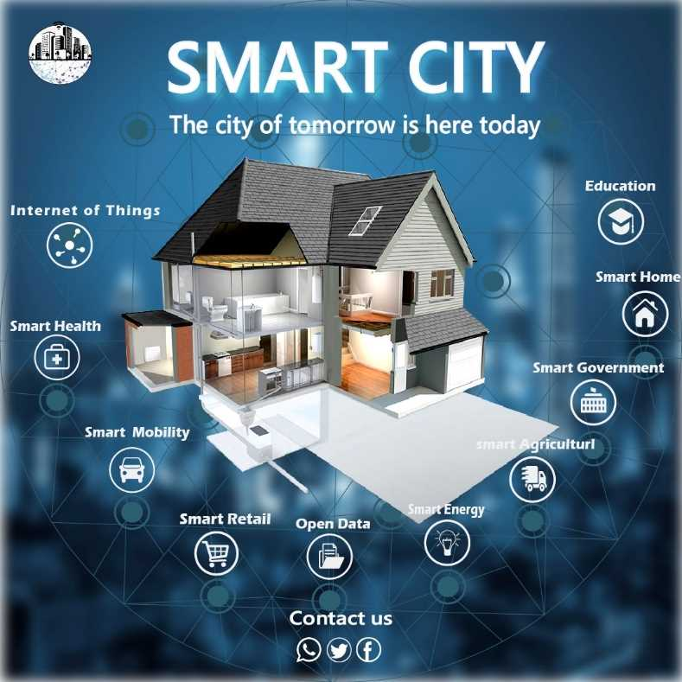
Visual Showcase
The first design focused on efficiency, sustainability, and connectivity.
Smart Infrastructure: Advanced and connected roads and transportation systems.
Vision for the Future: Emphasizing that current technology paves the way for future cities.
The second design showcases the core elements of modern smart cities.
Technology Integration: Integrating the Internet of Things, Smart Health, Smart Mobility, and Smart Retail to enhance life.
Smart Home & Smart Government: Technology applications in homes and government administration for increased efficiency and convenience.

Slide 17
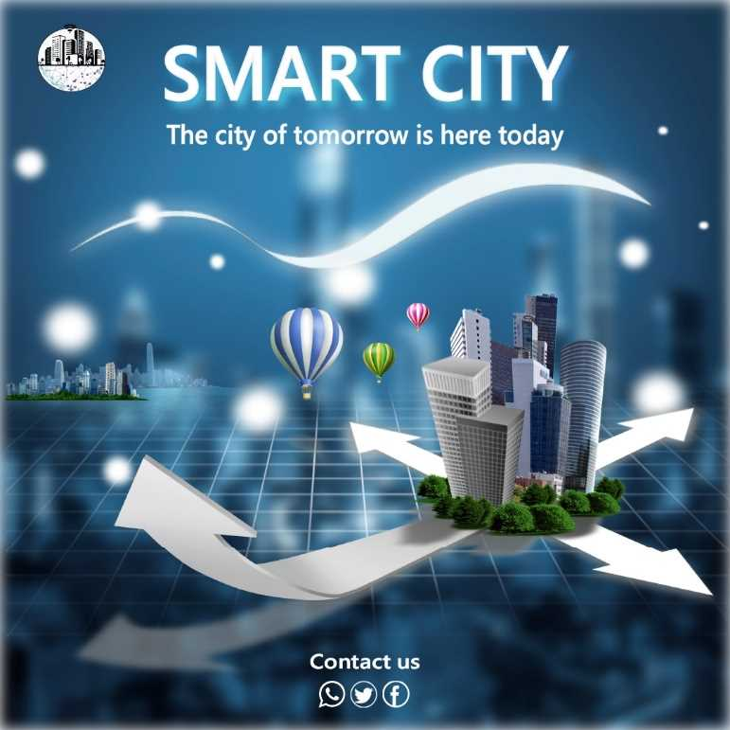
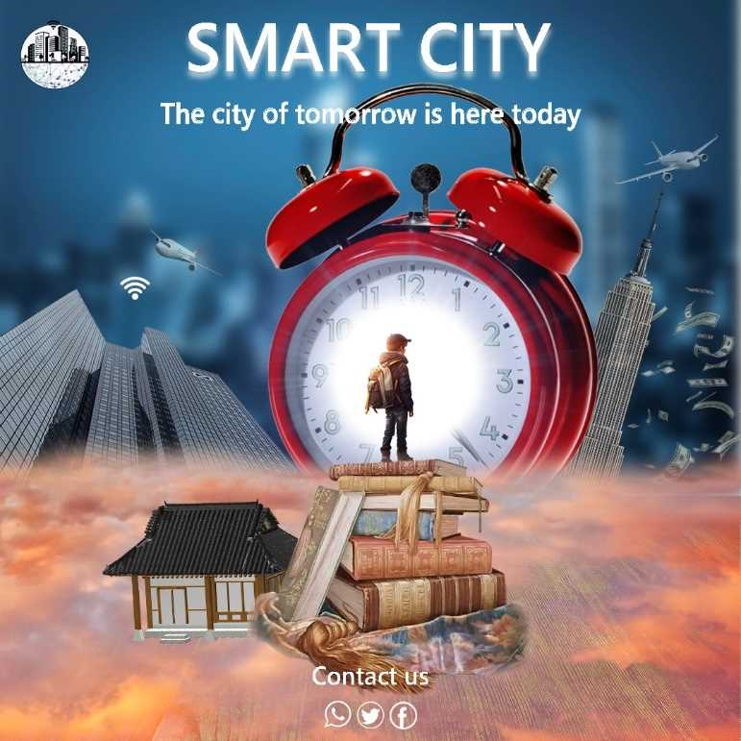
Visual Showcase
The first design Growth and Expansion of the Smart City: The white arrows indicate the future expansion and growth of smart cities.
Urban Development: Modern buildings and skyscrapers represent the urban evolution in smart cities.
The second design Smart City and the Next Generation: Focusing on the future of children in advanced smart cities.
Education is Key: The child standing on books symbolizes the importance of education in building the future.

Slide 18
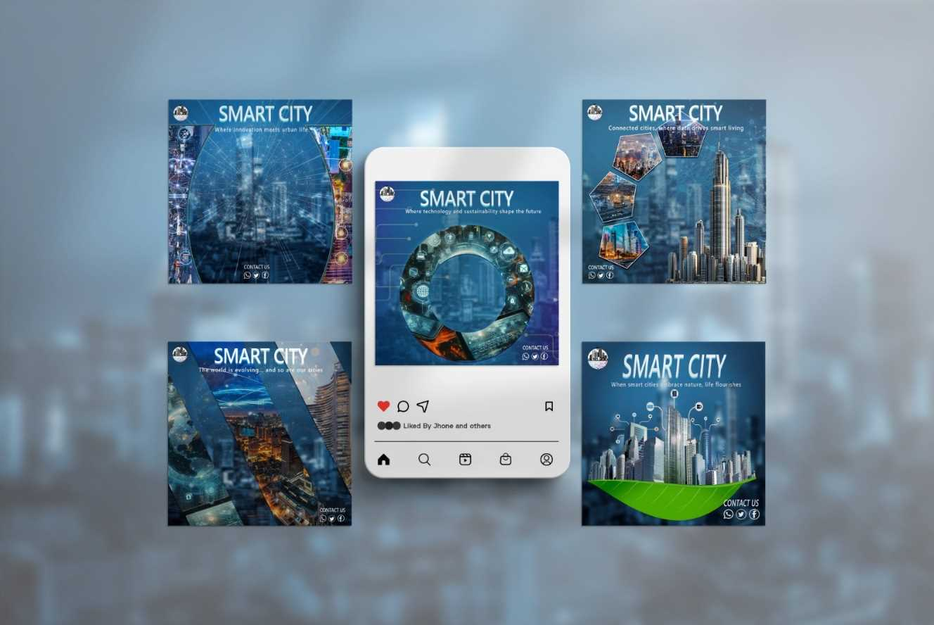
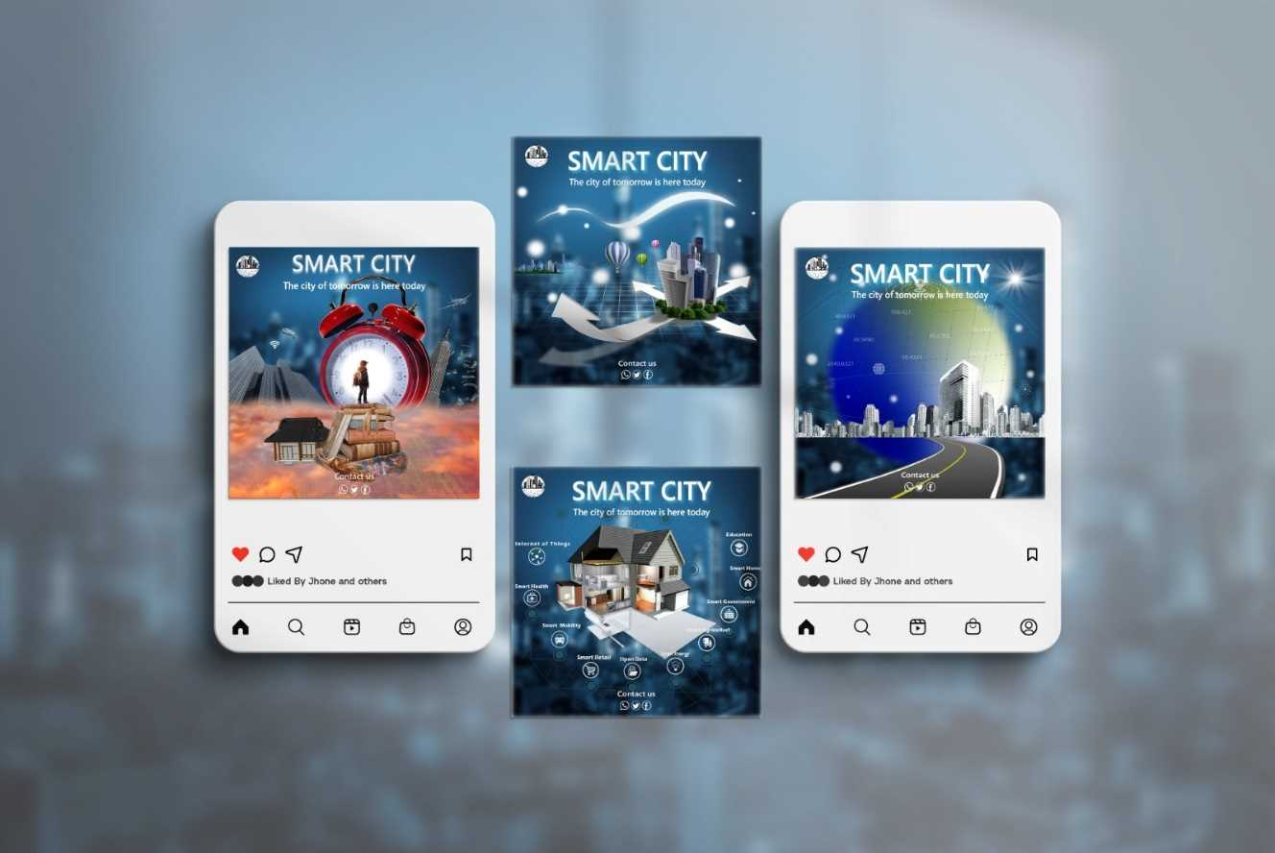
MOCKUPS

Slide 19
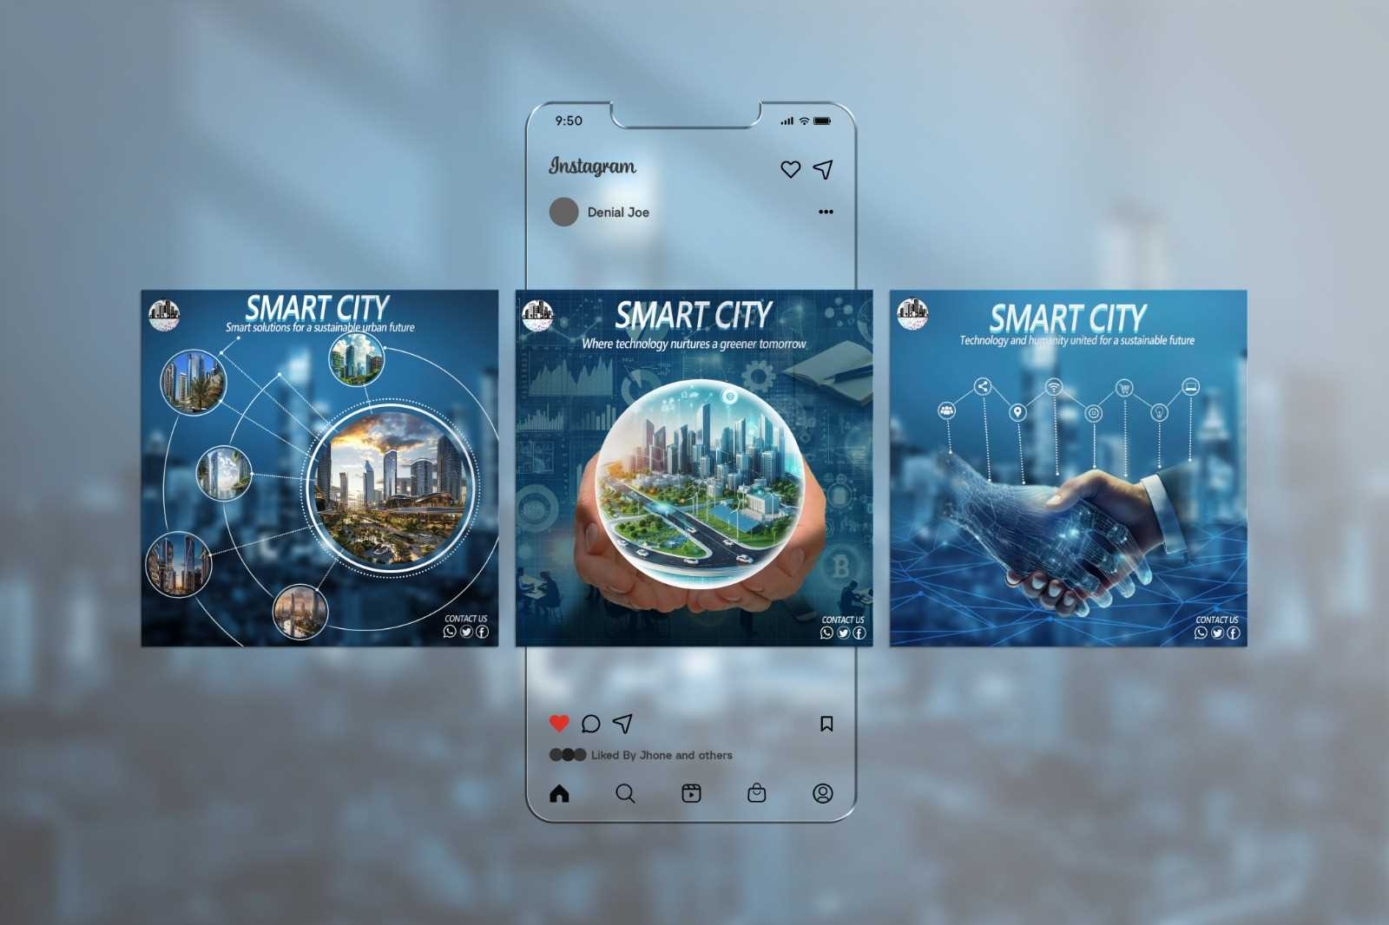
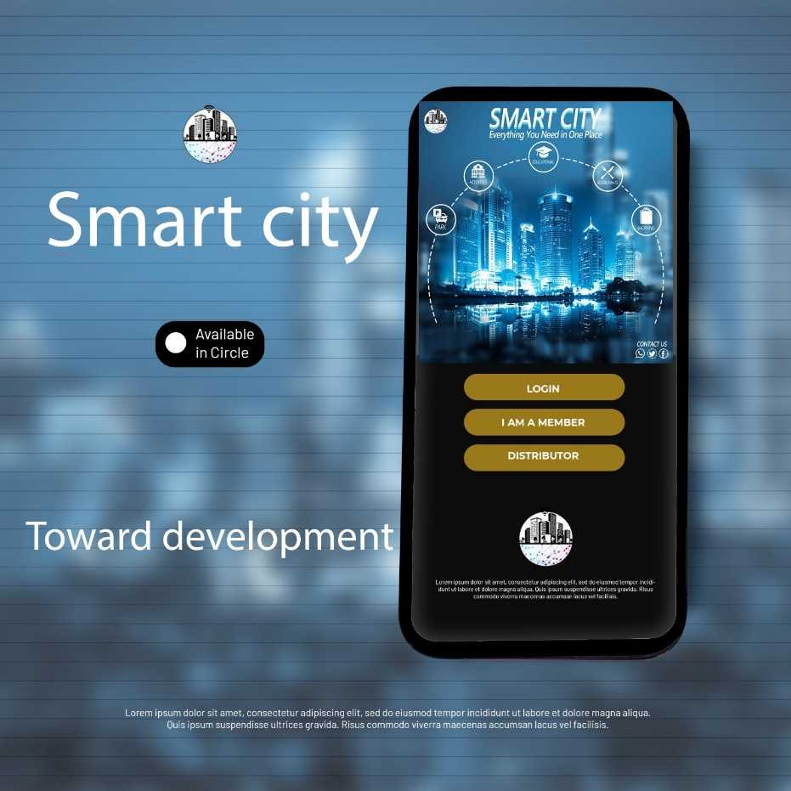
MOCKUPS

Slide 20
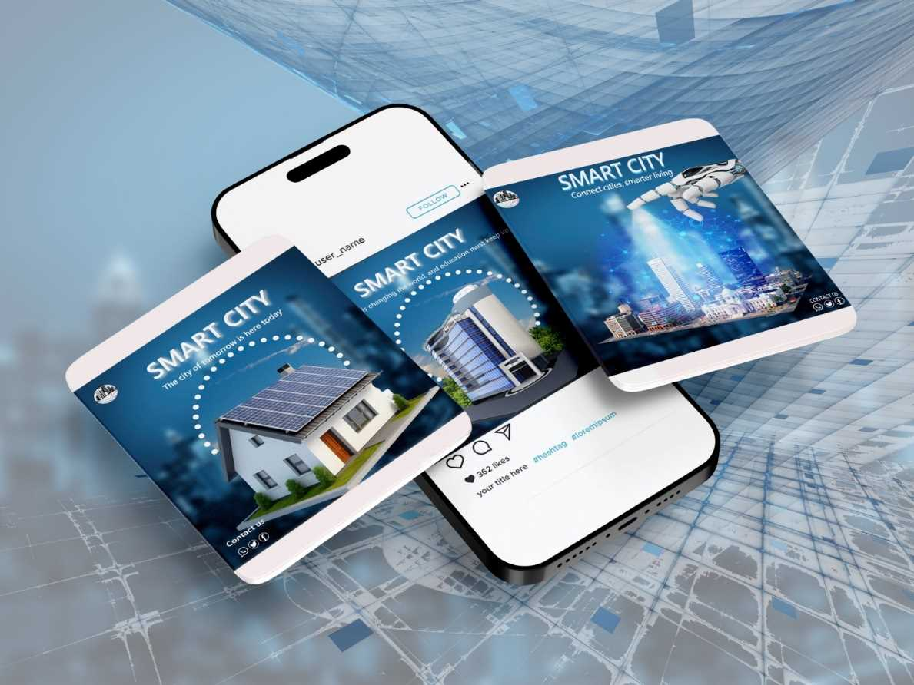
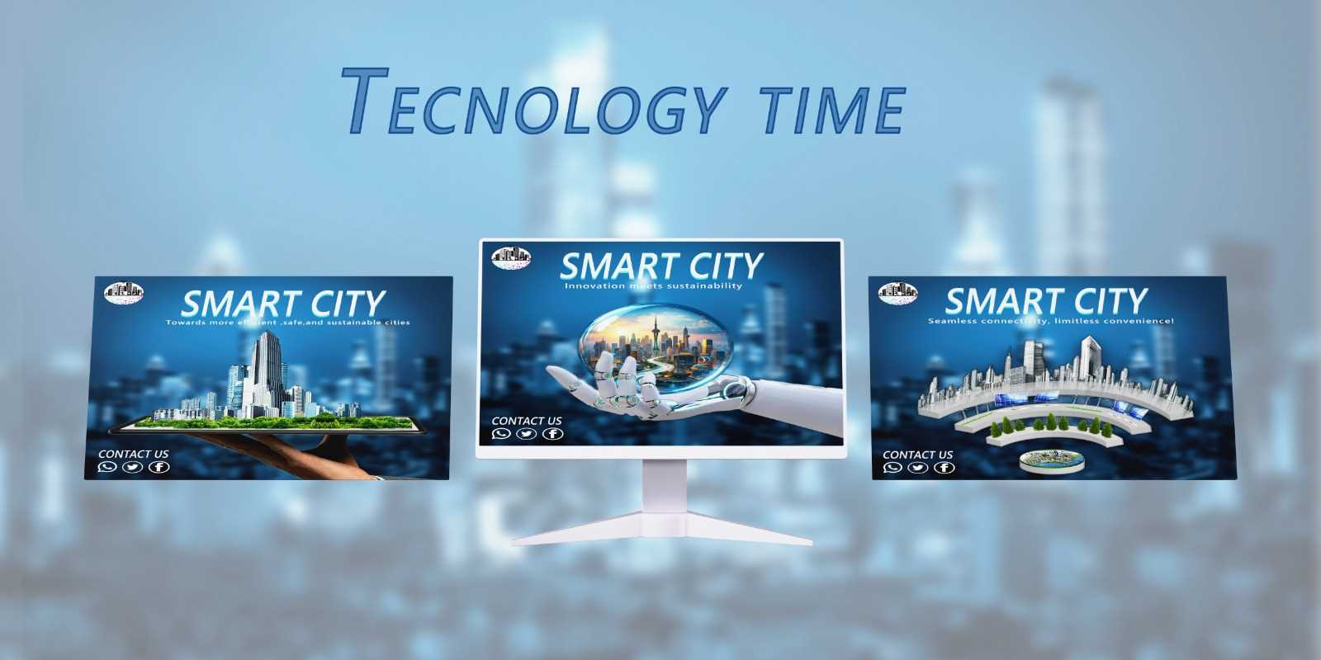
MOCKUPS

Slide 21
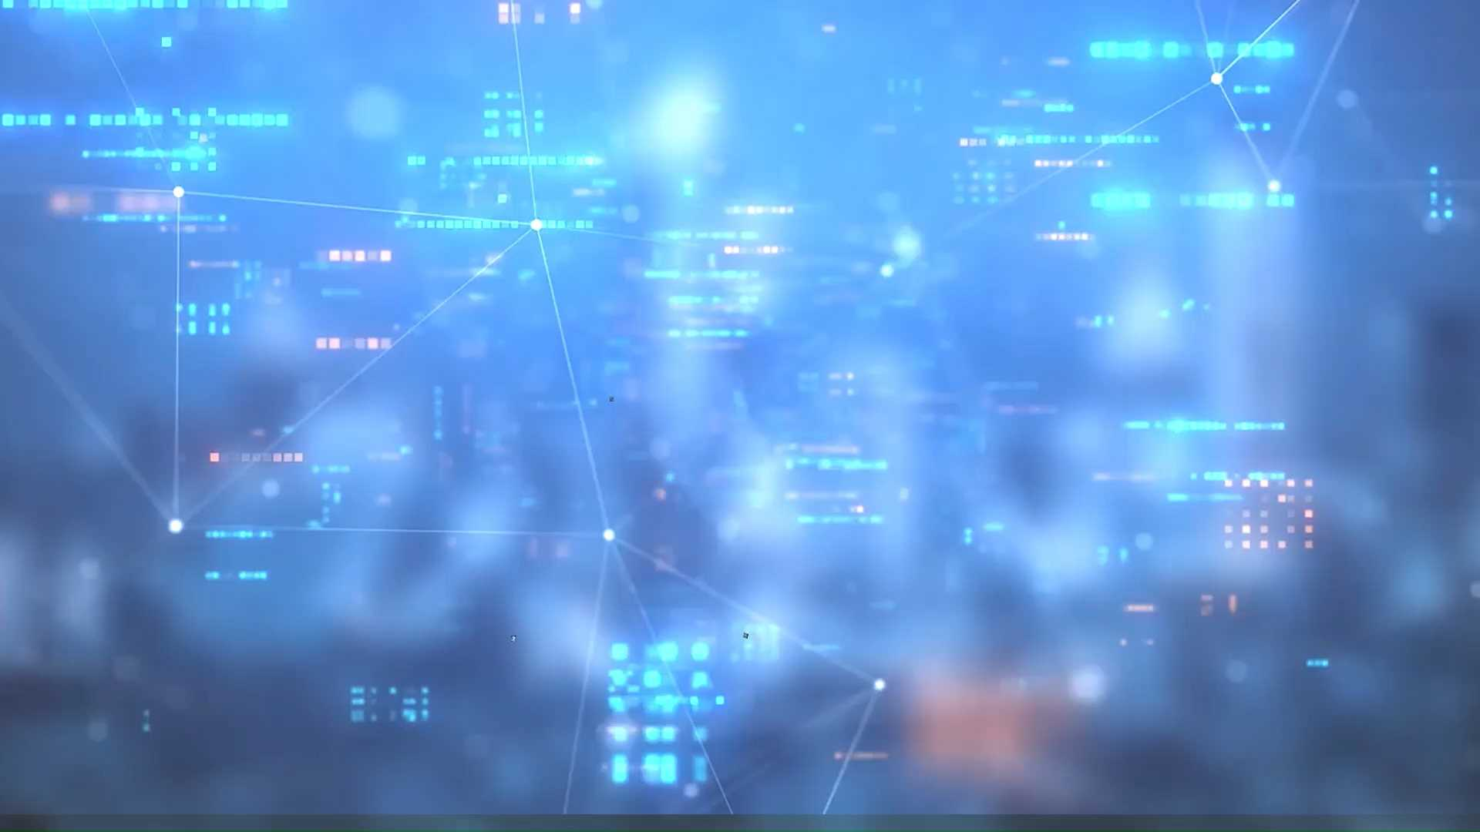
Motion graphic video

Slide 22
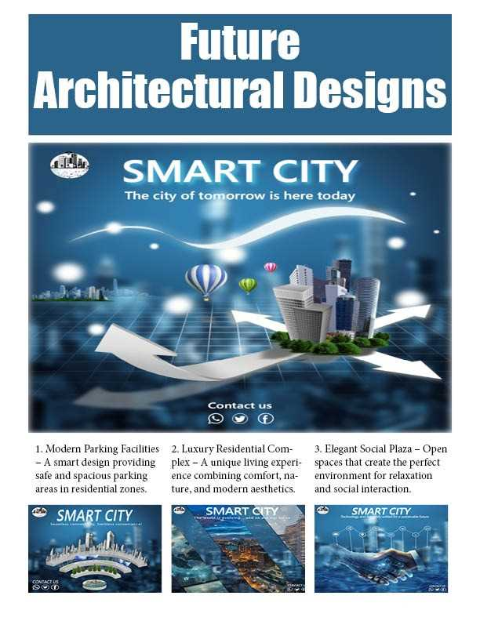
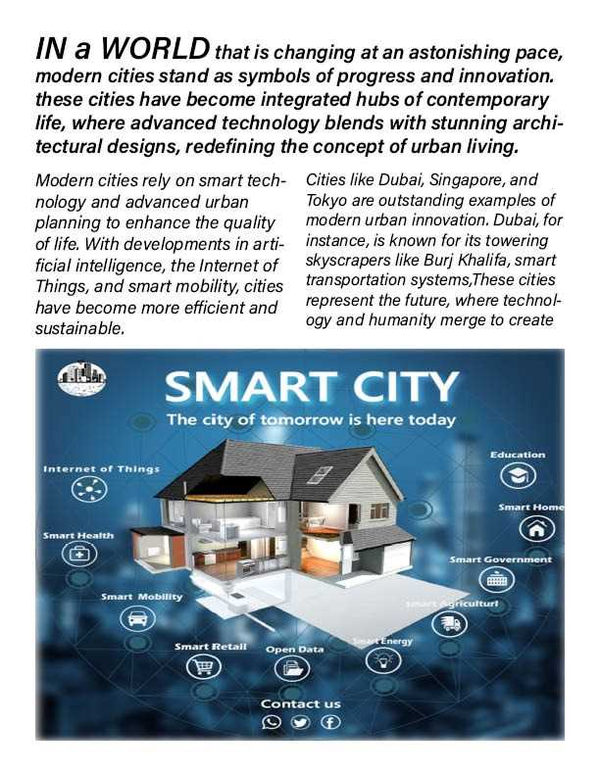
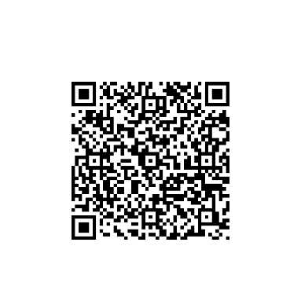
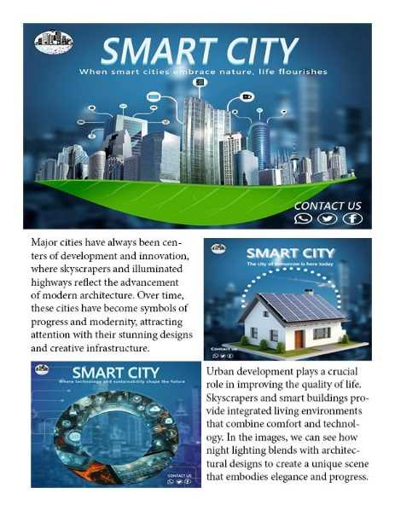
OUR MAGAZINE
SCAN ME TO SEE MORE

Slide 23
COLORS AND FONTS
FONT : YU GOTHIC UI BOLD \ SEMIBOLD
COLORS
#F2F2F2
#2D5F73
#9FB9BF
#1C588C
#5A7340

Slide 24

Challenges and solutions
Points
Difficulty in visually simplifying a complex technical concept.
Choosing appropriate colors that convey “modernity and intelligence.”
Integrating technology elements without creating visual clutter.
Solutions
Relying on clear and recognizable icons.
Utilizing white space effectively.
Structuring elements using a visual hierarchy.

Slide 25
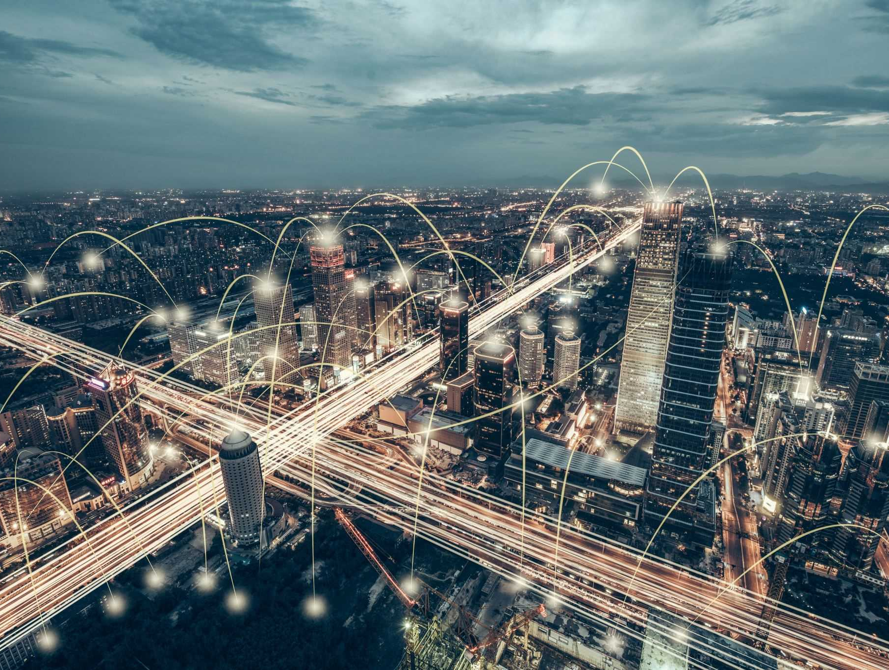
Project added value
The project highlights the importance of transitioning to smart cities by raising awareness about sustainability, smart technologies, and improving quality of life. It demonstrates how modern technology can solve traditional urban challenges such as congestion, pollution, and weak infrastructure.
How Does the Project Help the Target Audience?
The project helps the target audience – whether students, researchers, or government entities – understand the benefits of smart cities through clear and visually appealing communication. It simplifies complex technical concepts, encouraging the adoption of smart solutions in daily life or professional environments.
How Can the Project Be Further Developed?
Adding interactive content or animations to illustrate ideas more effectively.
Expanding the research scope to include real-world case studies from existing smart cities.

Slide 26

Thank you for your time

